Slide 1
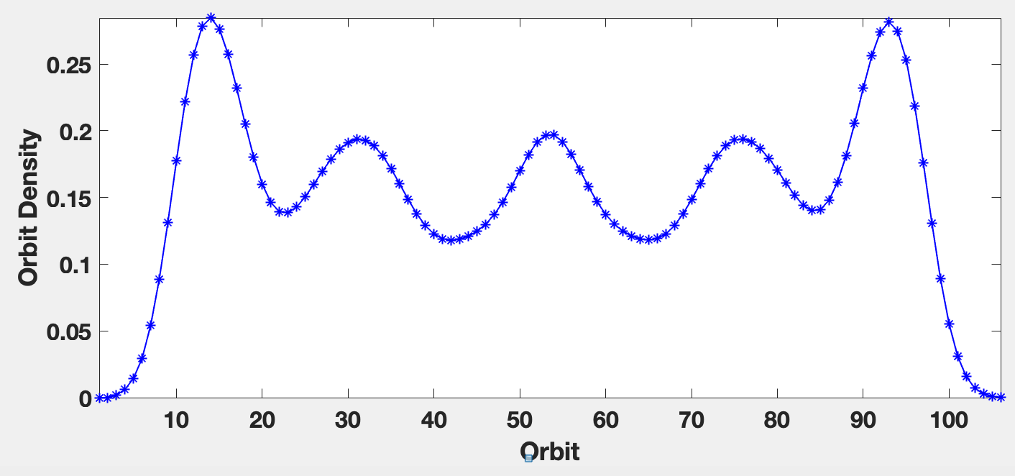
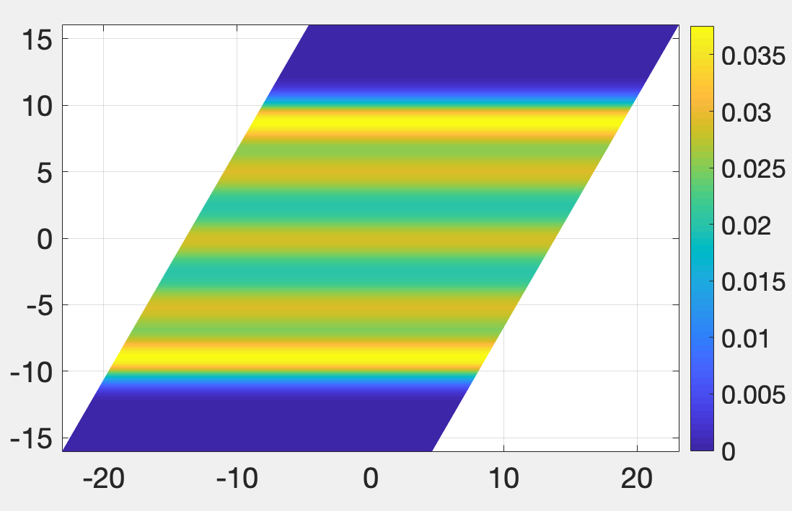

N_{e}=16, v =1/7, Orbits=106, ratio=1, $μ=0.0001$
parallelogram
Pair correlation function
Electron density

